Slide 1
Outbreak: Preventing the Spread of Infectious Disease PBL Innovation Academy
Tom Brown
K-12 Science Supervisor
Michelle Mikes
K-12 Math Supervisor
http://www.ccsdscience.com/index.html

Slide 2
Goals for this session
Introduce Cobb PBL Template
Spotlight Cobb PBL resources
Showcase model of Infectious Disease PBL
Spotlight Cobb PBL resources
Networking and collaboration

Slide 3
Characteristics of PBL Learning….
Focused on open-ended question or problem
Provide students with opportunities to apply of content and skills to the real-world
Build 21st Century skills of creativity, communication, collaboration, critical thinking
Enable students to “dig deeper” into concepts using a multifaceted integrated approach
Emphasize student inquiry

Slide 4
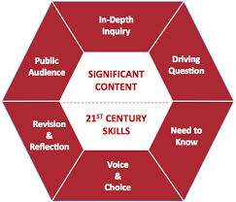
The PBL Process (Buck Institute)

Slide 5
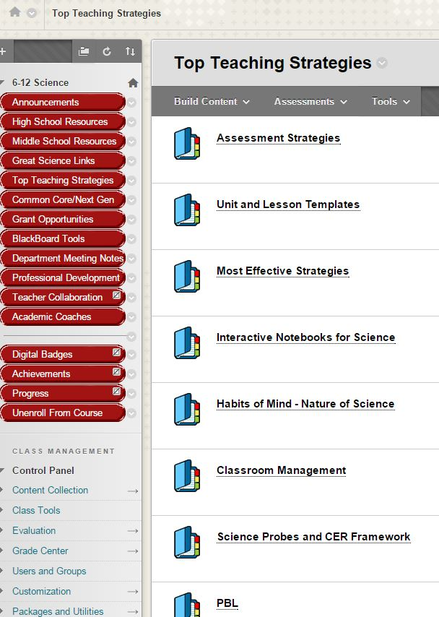
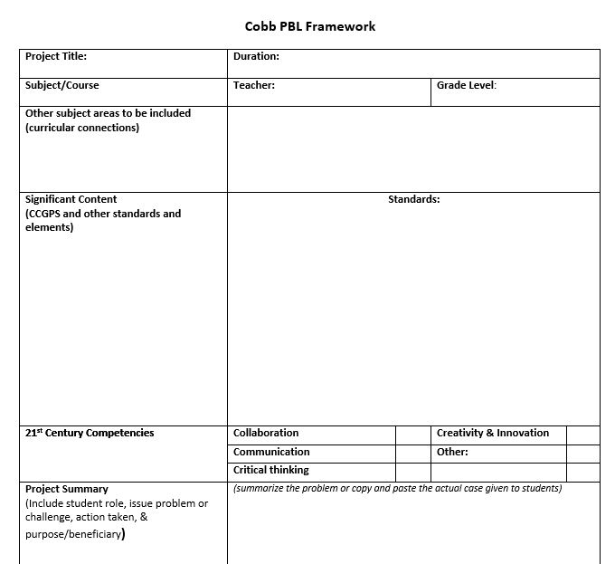
Cobb PBL Framework

Slide 6
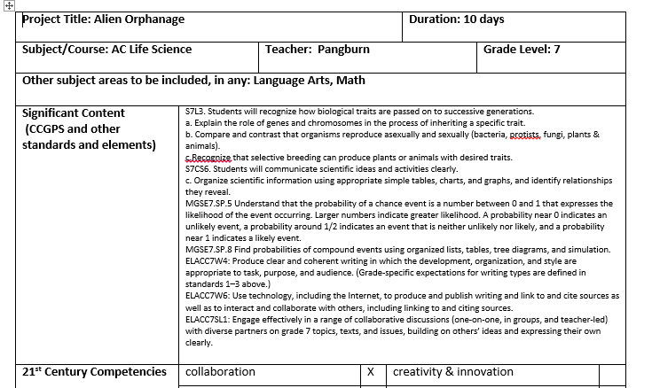
Current Cobb PBL Challenges (located in Bb at bottom of each middle school unit)

Slide 7
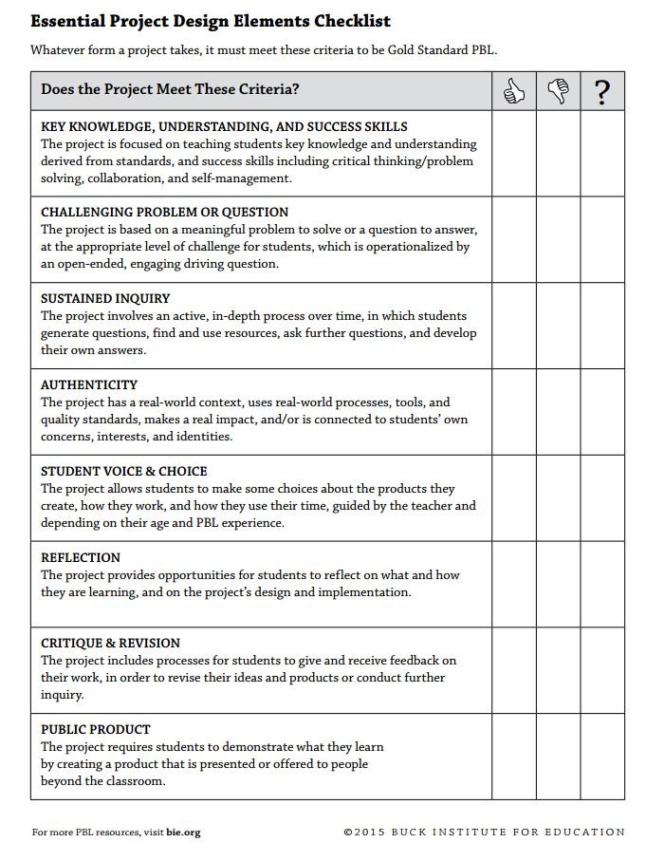
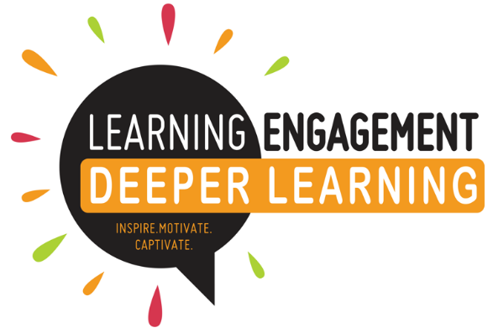
Buck Institute Project Checklist

Slide 8
Alien Orphanage
What do you like the most about this framework?
What suggestions do you have for improvement?

Slide 9
Tweaking a PBL
Check out already written cases posted online:
The Buck Institute- www.bie.org
WVDE- http://wveis.k12.wv.us/teach21/public/project/Mainmenu.cfm
University of Buffalo- http://sciencecases.lib.buffalo.edu/cs/
Emory CASES- http://www.cse.emory.edu/cases/
PBL Symbaloo- http://www.symbaloo.com/home/mix/13eP26Yb2K

Slide 10
Outbreak: Preventing the Spread of Infectious Disease
3 Questions to Consider:
What PBL challenge or project idea to should be used to frame the unit?
What content areas, standards, and skills will be addressed?
What best-practice activities, labs, lessons can be integrated into the unit?

Slide 11
What PBL challenge or project idea to should be used to frame the unit?
Students will create a Public Service Announcement for the CDC regarding a “mystery” pathogen that may be a threat to the Atlanta area.
As part of this exploration, they will complete guided research activities involving viruses and bacteria and they will collect and identify microorganisms within their local environment.

Slide 12
What content areas, standards, and skills will be addressed?
Biology Standards:
SB3. Students will derive the relationship between single-celled and multi-celled organisms and the increasing complexity of systems.
b. Compare how structures and function vary between the six kingdoms
d. Compare and contrast viruses with living organisms
SB5. Students will evaluate the role of natural selection in the development of the theory of evolution.
d. Relate natural selection to changes in organisms
e. Recognize the role of evolution to biological resistance

Slide 13
What content areas, standards, and skills will be addressed?
Algebra I Unit 4:
Modeling & Analyzing Exponential Functions
Standards:
MCC9-12.A.CED.2 Create linear, quadratic, and exponential equations in two or more variables to represent relationships between quantities; graph equations on coordinate axes with labels and scales.
MCC9-12.F.IF.7e Graph exponential functions, showing intercepts and end behavior

Slide 14
What best-practice activities, labs, lessons can be integrated into the unit?
Growth of Bacteria Lab
The Bean Activity: Simulating Exponential Growth
Disease Prevention Activity: Zombie Outbreak
Preventing the Spread of Disease Simulation
Local Food Inspections: How Did Your Favorite Restaurant Rate?

Slide 15
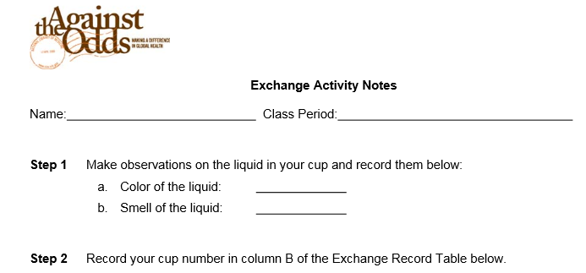
Science and Society: Preventing the Spread of Disease
2 Excellent Lessons that focus on the spread of infectious disease.
Simulation Activity
Case Study Exploration
Source: http://apps.nlm.nih.gov/againsttheodds/pdfs/ss/lesson_plan_science_and_society.pdf

Slide 16
Infectious Disease PBL Resources http://www.ccsdscience.com/index.html
Project-based Learning – Preventing an “Outbreak”
Infectious Diseases (Kara Kits)
Infection Control to Prevent Illness and Analyzing Exponential Functions
(complete unit integrating Anatomy and Physiology, Mathematics,
and Healthcare Science)

Slide 17
SUGGESTIONS
Start small
Look for opportunities to integrate PBL into existing curriculum
Schedule frequent benchmark goals to ensure that students don’t fall behind
Collaborate with your peers – find a buddy to try it with you!
Ask for help!
Build your Professional Learning Network (PLN)
Start with Twitter - Checkout #PBL, @BIEpbl
#stemcobb, #pblchat #Deeperlearning,

